Slide 1
Data Mining for Business Analytics

Slide 2
Learning Objectives
Understand the objectives and benefits of machine learning as a technique of Data mining (Business Analytics)
Understand the process of data mining
Learn selected methods and algorithms of Clustering as a Data mining technique

Slide 3
What Does Data Mining (DM) Do?
DM extract patterns from data
Pattern = A mathematical (numeric and/or symbolic) relationship among data items
Types of patterns (Machine Learning model)
Supervised Learning for prediction
Classification e.g. spam vs. not spam
Regression e.g. stock prices
Unsupervised Learning for grouping similar attributes
Cluster e.g. customer segmentation
Association Mining e.g. market basket analysis
Dimensionality reduction e.g. reduce attributes for modeling

Slide 4
Data Mining Process: CRISP-DM

Slide 5
Data Mining Overview
Business understanding: situational context, specific objectives, deliverables
Data understanding: collecting raw data, preliminary results, potential hypotheses
Data preparation: records and variable selection, wrangling, cleaning
Modeling: selection and execution of data mining techniques, convert or transform data to formats/types needed by certain analyses or assumptions, validation
Evaluation: evaluate performance of competing models, select best models, review and interpret results, develop recommendations
Deployment: develop a set of actionable insights and a strategy for deployment/monitoring/feedback

Slide 6
Data Preparation – A Critical DM Task

Slide 7
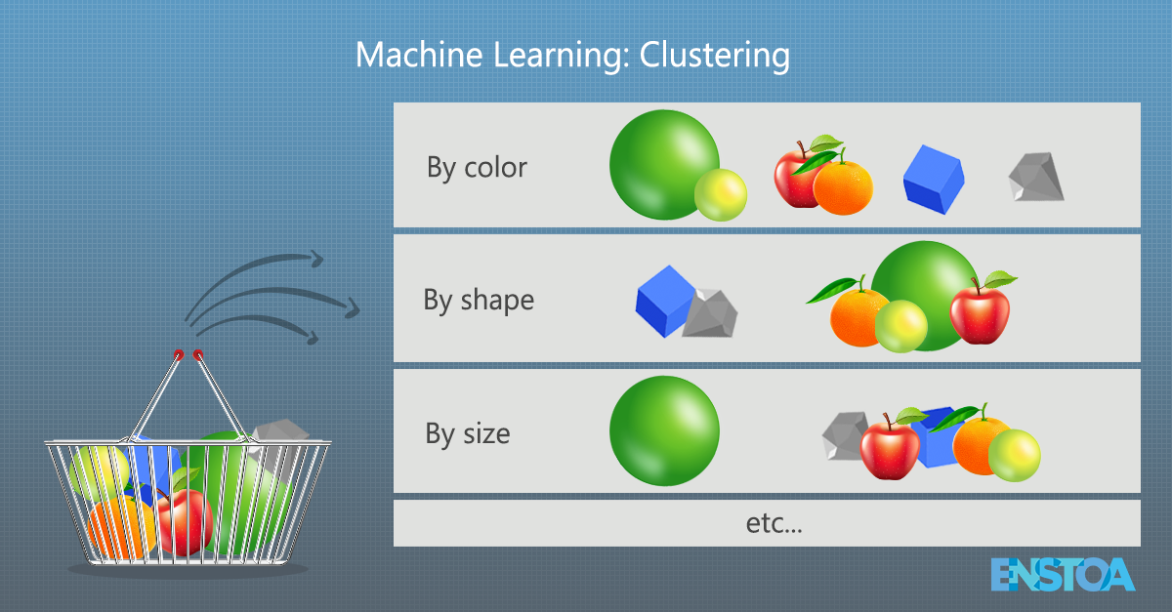
Clustering: Unsupervised machine Learning
Used for automatic identification of natural groupings of things
May used to generate label (Prior to supervised learning)
Employ unsupervised learning
Also known as segmentation
Example:
Reduce variables from IoT’s devices which tend to have a lot of redundant data.
Segment customers into groups for customized product and service offerings

Slide 8
Cluster Analysis
Example of available methods
Algorithmic and Statistical methods (k-mean, Hierarchical Clustering)
Neural networks (adaptive resonance theory [ART], Self-Organizing Map [SOM])
Association mining (Apriori, Frequent Pattern Growth)

Slide 9
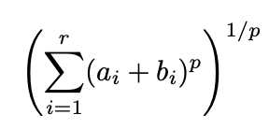
Cluster Analysis for Data Mining
Most Statistical cluster analysis methods involve the use of a distance or similarity measure to calculate the closeness between pairs of items
Usually, the “Minkowski distance”
Based on the distance between observations
Small distance implies high similarity
Large distance implies low similarity

Slide 10
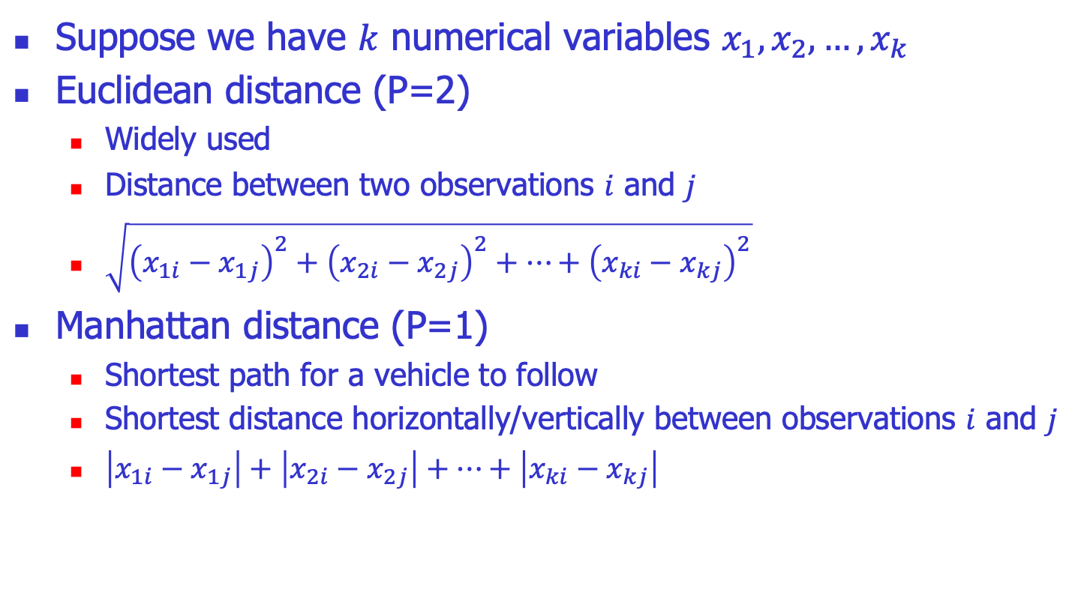
Similarity Measures for numerical data
Suppose we have $k$ numerical variables $x_{1},x_{2},…,x_{k}$
Euclidean distance (P=2)
Widely used
Distance between two observations $i$ and $j$
$\sqrt{{\left(x_{1i}−x_{1j}\right)}^{2}+{\left(x_{2i}−x_{2j}\right)}^{2}+…+{\left(x_{ki}−x_{kj}\right)}^{2}}$
Manhattan distance (P=1)
Shortest path for a vehicle to follow
Shortest distance horizontally/vertically between observations $i$ and $j$
$\left|x_{1i}−x_{1j}\right|+\left|x_{2i}−x_{2j}\right|+…+\left|x_{ki}−x_{kj}\right|$

Slide 11
Similarity Measures
Example
Calculate and interpret the Euclidean distance.
Calculate and interpret the Manhattan distance.

Slide 12
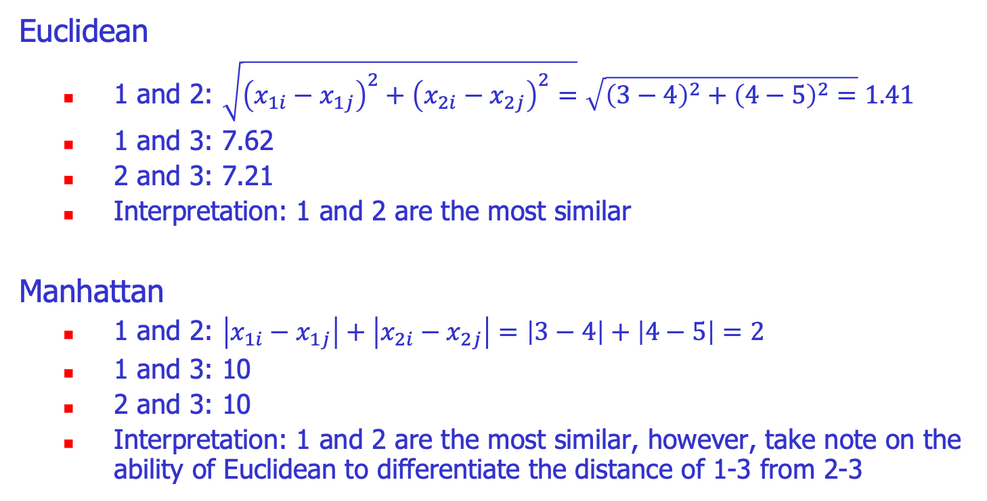
Similarity Measures
Euclidean
1 and 2: $\sqrt{{\left(x_{1i}−x_{1j}\right)}^{2}+{\left(x_{2i}−x_{2j}\right)}^{2}=}\sqrt{{\left(3−4\right)}^{2}+{\left(4−5\right)}^{2}=}1.41$
1 and 3: 7.62
2 and 3: 7.21
Interpretation: 1 and 2 are the most similar
Manhattan
1 and 2: $\left|x_{1i}−x_{1j}\right|+\left|x_{2i}−x_{2j}\right|=\left|3−4\right|+\left|4−5\right|=2$
1 and 3: 10
2 and 3: 10
Interpretation: 1 and 2 are the most similar, however, take note on the ability of Euclidean to differentiate the distance of 1-3 from 2-3

Slide 13
Clustering: The K-Means Algorithm
Choose K, the number of clusters.
Randomly choose K points as cluster centers.
Assign the remaining instances to their closest cluster Center or Centroid, e.g.,
Based on Minkowski distance to the center.
Calculate a new cluster center for each cluster, e.g.,
Average values of all member in the cluster
Repeat steps 2-4 until the cluster centers do not change (Convergence).

Slide 14
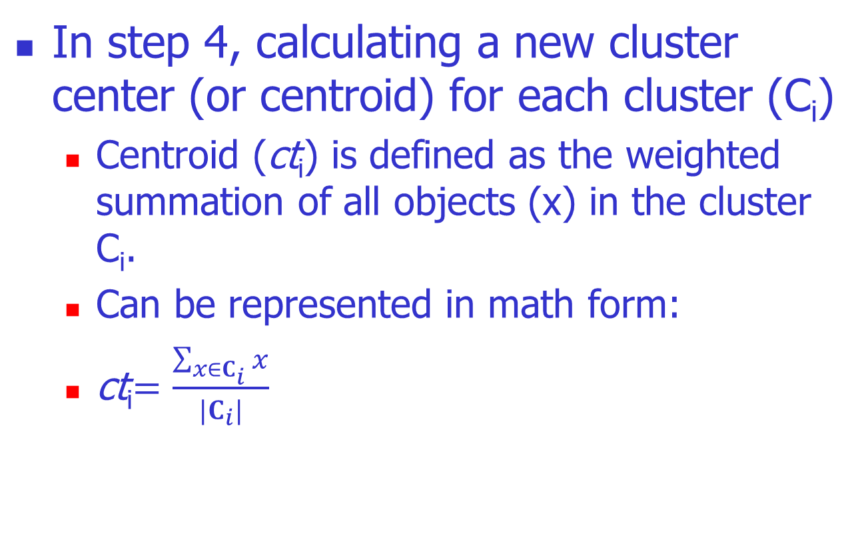
Note for generating the new center of clusters.

Slide 15
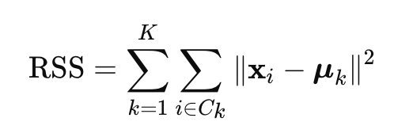
Clustering performance
Clustering with K clusters, K=1,…,i where each cluster has a center μ_{k}​​, contains data points x_{i}, can be measured for its performance using:
∥x_{i}​−μ_{k}​∥² = Squared Euclidean distance between a point and the cluster centroid
It quantifies how tightly the data points in a cluster are grouped around the cluster centroid.
The tighter the better

Slide 16
Finding the optimal K
Choosing k: Use the Elbow Method or Silhouette Score to find the optimal k.
Scalability: K-Means works well for large datasets but may struggle with very high dimensions.
Limitations: Sensitive to initial centroids and cannot handle non-convex clusters well.

Slide 17
Elbow Method – Finding the Optimal k
The Elbow Method evaluates how the RSS (Residual Sum of Squares) or Inertia changes as you increase k.
The optimal k is at the "elbow point," where additional clusters provide diminishing returns in reducing inertia.

Slide 18
An example of K-Means

Slide 19
General Considerations
Requires real-valued data.
We must select the number of clusters present in the data.
There is no “truly optimal” way to calculate it
Practically, start from 1 clusters until obtain the best RSS, or
Heuristics rule.
Look at the sparseness of clusters
Number of clusters = (n/2)^{1/2} (n: no of data points)
Attribute significance cannot be determined.

Slide 20
Objectives Review
Data mining = process of identifying patterns in data stored in structured databases
Unsupervised learning
Silimarity measure (Minkowsky distance)
Clustering, sample method = k-mean

Slide 21
Further readings
K-mean clustering http://home.deib.polimi.it/matteucc/Clustering/tutorial_html/kmeans.html

